Slide 1
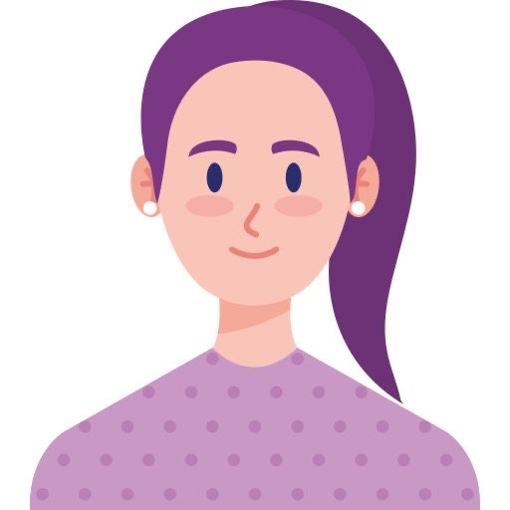
“I’m a passionate university student with lots of hope for my future and I’m also a flower lover”
Goals
Show my attention to details
Keep the workplace fresh
Surprise family members occasionally
Frustrations
I have busy schedule because of both working and studing
It’s hard to find a florist with reliable out-of-town delivery option.
It’s hard to find a florist which offers unique and uncommon flowers.
monica
Age:
Education:
Hometown:
Family:
Occupation:
22
University student
Bruges, Belgium
2 sisters
Project management intern for a large firm
Monica is a 22-year-old woman, she lives in belguim with her younger sister, she has also another older sister who lives in the suburb and she is relly interested in unique and unusual flowers. Monica is a 4th-year university student and also works as a project management intern for a large international firm so she has a very busy schedule and must try to keep herself uplifted with her favorite activities and elements during working hours.

Slide 2
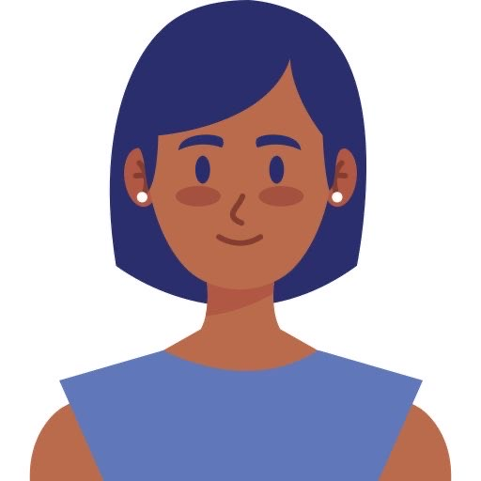
“I am a teacher who has lovely students, I love them with whole my heart and always try to give them the best experience”
Goals
Encourage my students to do their best
Try to do my job in different and positive way
Try to make a friendly atmosphere in my classes
Frustrations
I have to order the flowers daily in advance
I have limited budget so I prefer to order flowers with reasonable price
I would appreciate some discount on my daily purchase
Sarah
Sarah is a teacher. She is passionate about her job, her workplace and also her students. Sarah always tries to make her class atmosphere fresh and inspiring by different ways to encourage her students and energize them, for example every session she gives some flowers as a gift to active students. But she has to manage this activity with limited budget.
Age:
Education:
Hometown:
Family:
Occupation:
40
Master degree education
Paris, France
Married with one child
Teacher

Slide 3
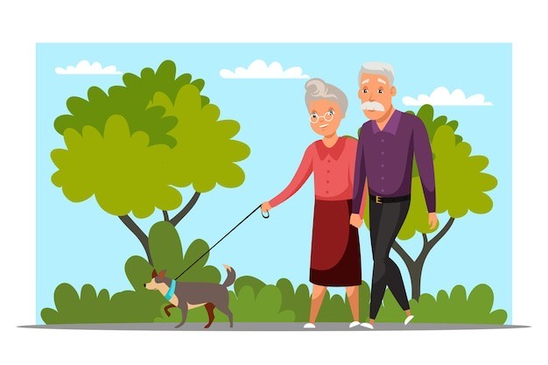
“we love each other and try to make our lives more beautiful and meaningful”
Goals
Make their house and garden beautiful and favorable
Build a exciting place for their grandchildren
Spend their time with pleasurable activities
Frustrations
It’s difficult to find suitable plants which their maintenance is easy
It’s difficult to find a florist who is knowledgeable about plants
Marry & John
Marry and John are a happy couple, they have 2 children and 3 grandchildren as well. They have a great relationship with each other and have a lot of things to do in common, for example they are fond of gardening and have a lot of beautiful plants in their little garden and in their house as well. Marry has visual impairment and John suffers from dyslexia so they face with difficulties in their daily activities and should find a way to cope with them. They do yoga exercise in their garden every day and spend their weekend with children and grandchildren, “Sophy, Tom, and Daniela”. All grandchildren love their grandparents a lot and have a memorable time in their lovely house.
Age:
Education:
Hometown:
Family:
Occupation:
70
High school and some college
New York city, New York
Couple with two children
Owner of small bookshop

